Slide 1
Please note
Everyone is being monitored, so any act of mischief is traceable.

Slide 2
Dos and Don’ts
Students to please follow the following etiquettes
Listen to the teacher's instructions carefully
Mute your microphones and turn off your cameras for a smooth session
Post all the queries in the chat box. Please do not post irrelevant messages in the chat box.
Do not meddle with the teacher’s audio/ppt.
The students must leave the group once the session is over. Please do not use this platform for personal conversations.
Maintain discipline

Slide 3
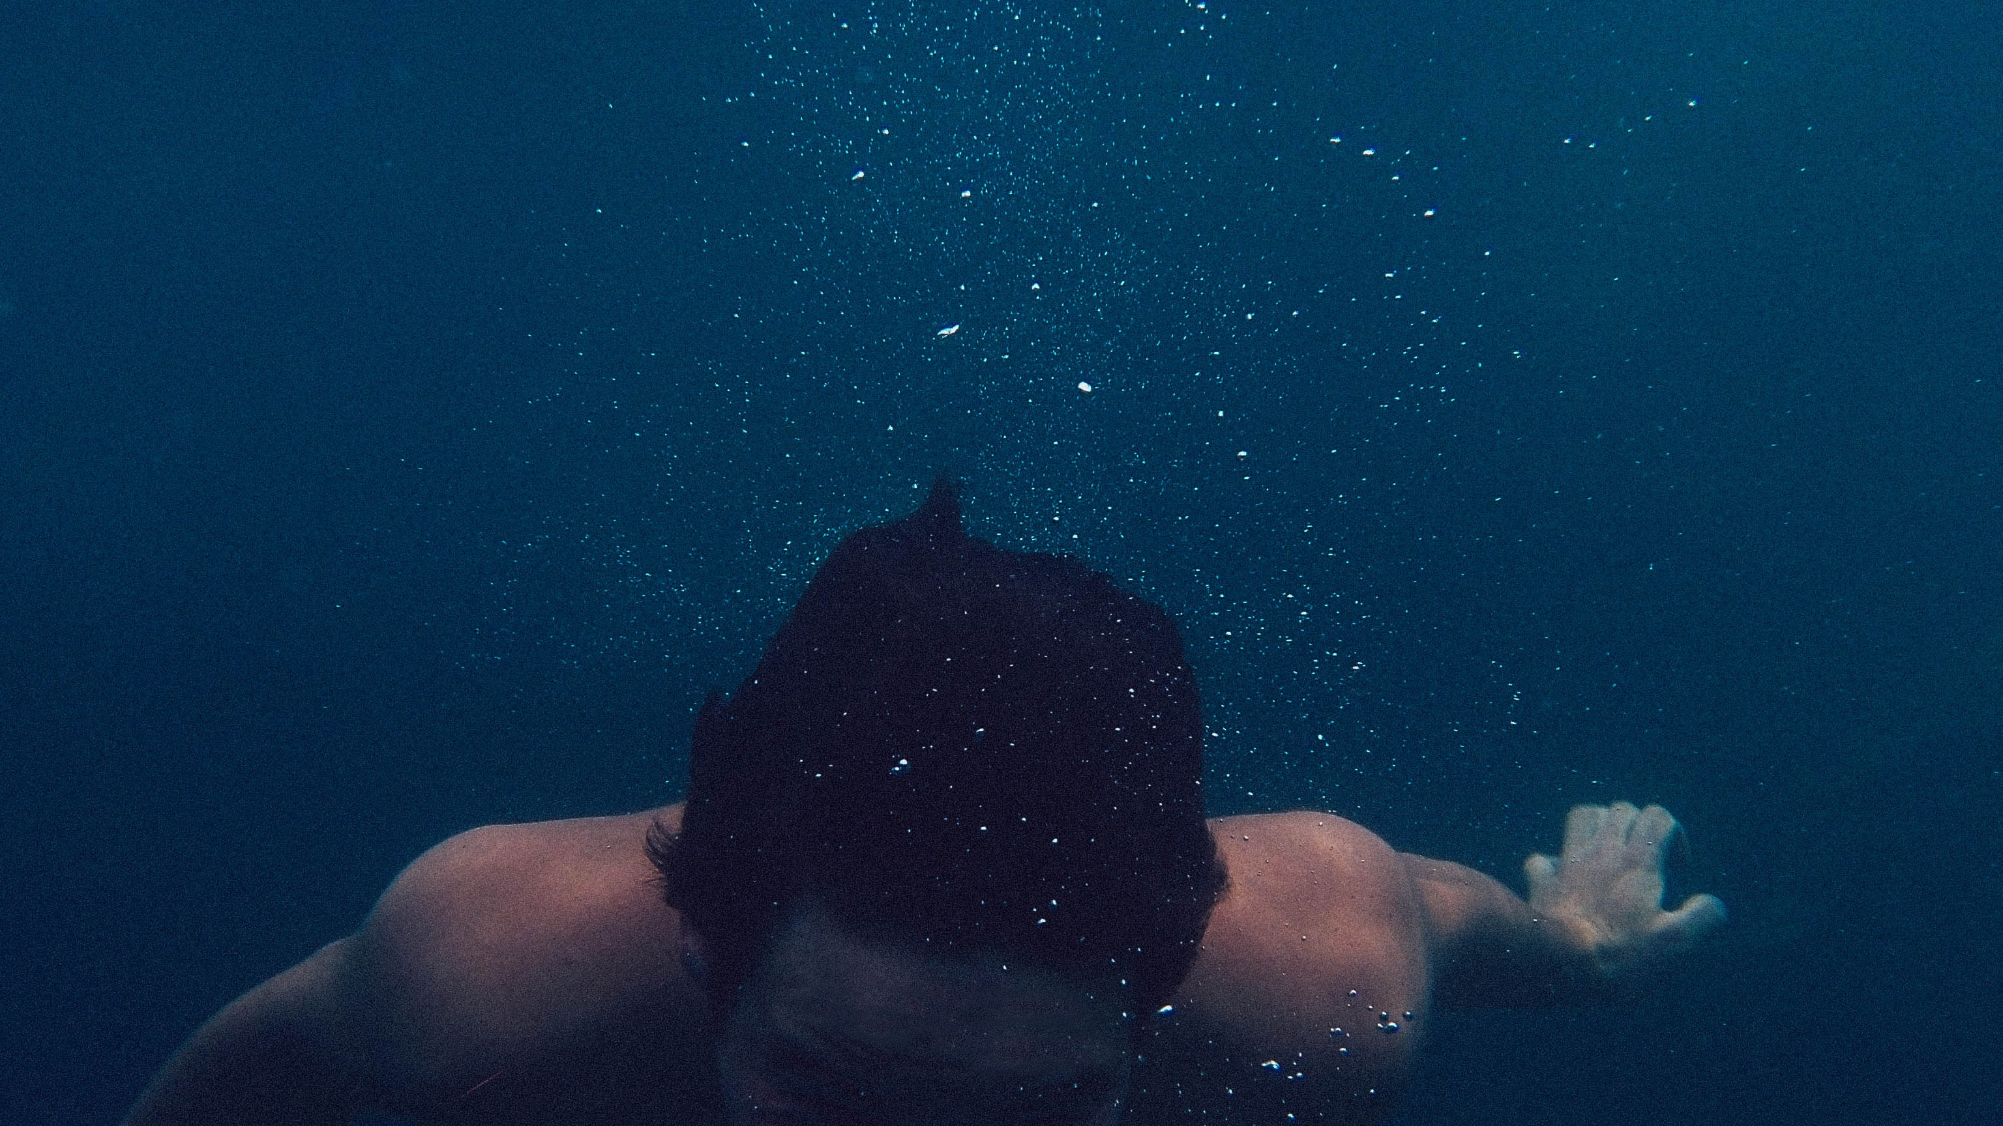
Deep Water
William Douglas

Slide 4
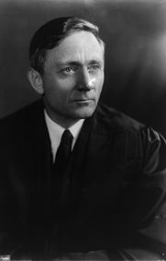
About the author
Born in Maine, Minnesota Graduated in English, Economics Became an adviser and friend to President Roosevelt Deep Water is an excerpt from ‘Of Men and Mountains’ An autobiographical account of how he overcame hydrophobia
This Photo by Unknown Author is licensed under CC BY-SA-NC
This Photo by Unknown Author is licensed under CC BY-SA

Slide 5
ABOUT THE CHAPTER
A real-life personal account of the author experiencing fear and the steps taken to overcome it.
Psychological analysis of fear.

Slide 6
Themes
Fear of Water Courage, will power and perseverance to overcome this fear

Slide 7
WORD BANK
Y.M.C.A. – Young Men’s Christian Association
Yakima – a place in Washington, USA
Treacherous – dangerous
Subdued – to overcome
Aversion – dislike
Revived – brought back to mind
Wobbly – weak

Slide 8
WORD BANK
Ducked - push or plunge someone under water
Wits – intelligence
Ceased – ended
Limp – lifeless
Oblivion - the state of being unaware or unconscious of what is happening around one
Curtain of life fell – life came to an end

Slide 9
WORD BANK
Cascades – waterfall
Canoes – small boats
Vestiges – traces
Aping - copying
To feel at ease – to feel comfortable
Bruiser - a person who is tough and aggressive and enjoys a fight or argument

Slide 10
IDIOMS RELATED TO FEAR
Make your blood run cold
Heart missed a beat
Scared out of my wits
Scared stiff
Fraught with danger
Quaking in one’s boots
at your wits' end

Slide 11
Douglas: Narrator of the story
YMCA Pool: A swimming pool runs by Young Men’s Christian Association
Yakima: Yakima is a US city located about 60 miles southeast of Mount Rainier in Washington.

Slide 12
Questions
How old was Douglas when the misadventure took place?
Nine to ten years old
Ten to eleven years
Eleven to twelve years
Twelve to thirteen years
Name the treacherous river mentioned in the chapter ‘Deep Water’
Bumping river
Thames river
Yakima river
Teton river

Slide 13
How did Douglas develop extreme fear of water?
Misadventure at Lake Wentworth
Misadventure at Meade Glacier
Misadventure at the Yakima River
Misadventure at YMCA pool
“This handicap stayed with me as the years rolled by.” What handicap is being referred to in the above sentence?
Fear of dark
Fear of water
Fear of heights
Fear of fishing

Slide 14
Fill in the blanks
Douglas father took him to a beach in ________
After the misadventure, whenever Douglas was near water, an icy __________ would grab his heart.

Slide 15
“From the beginning, however, I had an aversion to the water when I was in it.”
a. Who is ‘I’ in the above lines?
b. When did he start experiencing an aversion to water?
c. Why was he frightened?
d. How, according to you, did the boy feel when his father laughed at him?

Slide 16
Questions
Which two incidents in Douglas’ early life made him scared of water?
Why did Douglas prefer to go to YMCA swimming pool to learn swimming?

Slide 17
Questions
What were the series of emotions and fears that Douglas experienced when he was thrown into the pool?
What efforts did Douglas make to get over his fear of water?

Slide 18
Questions
How did his swimming instructor ‘build a swimmer’ out of Douglas?
When Douglas realise that he was sinking, how did he plan to save himself?

